Slide 1
MY BANK BANKING APPLICATION
TEAM : FINANCE TITANS
MODULE : PAYMENT TRANSFER

Slide 2

Agenda
Introduction
Features
Architecture Diagram
DB Design
Dataflow Diagram

Slide 3
Introduction
The payment transfer module is a fundamental component within financial systems, enabling the movement of funds between accounts. This includes transfers within the same financial institution or between different institutions, as well as processing different types of payments like RTGS,NEFT and IMPS payments. Here use can add the payee and delete the payee.

Slide 4
Features
Display all payees
Delete payee
Add new payee
Transaction

Slide 5
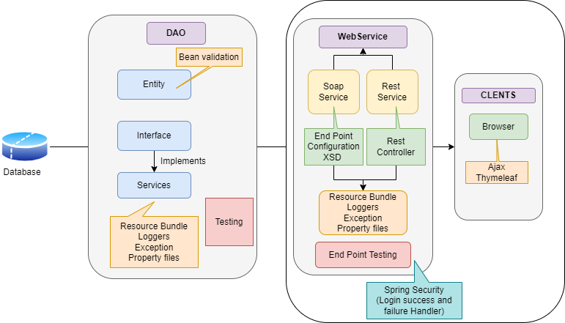
Architecture Diagram

Slide 6
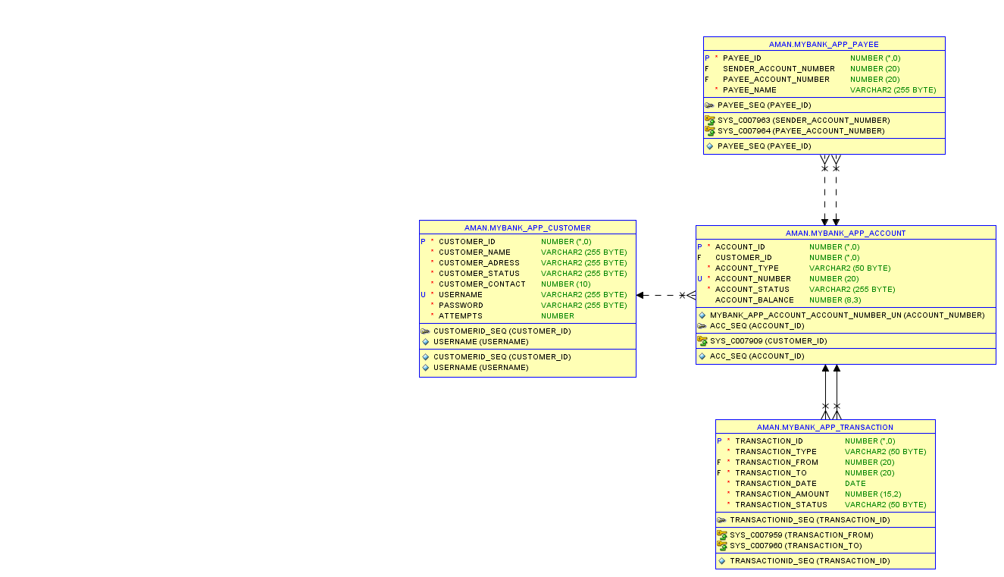
Database Design
Enhancing your presentation

Slide 7
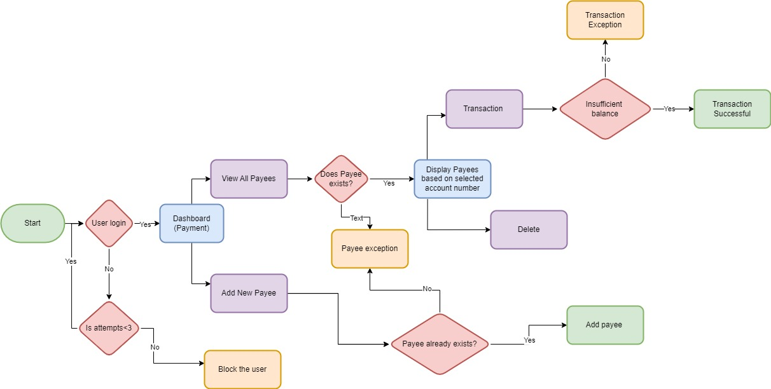
Dataflow Diagram

Slide 8
Thank you

